Slide 1
The Frequency Perspective in Deep Learning
From Spectral Bias to Frequency-Aware Architectures
Haowen Yu

Slide 2
The "Hidden" Dimension
Concept: Analyzing Neural Networks through the lens of Fourier Analysis rather than just the spatial domain.
Agenda:
Theory: Why neural networks learn low frequencies exponentially faster (NTK & Spectral Bias).
The Flaw: Modern CNNs violates Nyquist-Shannon Sampling Theorem (Shift-Invariance & BlurPool).
The Application: Actively designing of frequency-aware architecture.

Slide 3
Part 1: The Underlying Mechanism Why Neural Network Learns Low-Frequency Information Exponentially Faster
References:
Neural Tanget Kernel https://arxiv.org/abs/1806.07572
On the Spectral Bias of Neural Networks https://arxiv.org/abs/1806.08734

Slide 4
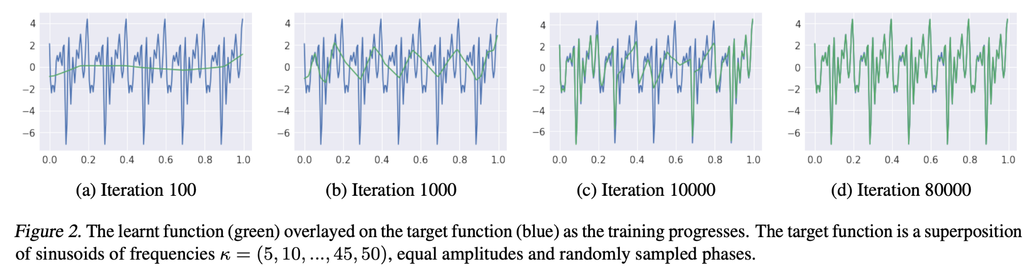
The Phenomenon: Lower Frequencies Learned First
Observation: Deep Networks prioritize learning simple, global patterns (low frequency). They struggle to fit high-frequency noise or fine details until much later in training.
Definition: This phenomenon is known as Spectral Bias.

Slide 5
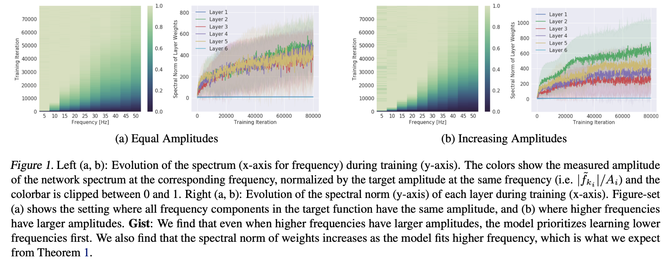
The Phenomenon: Lower Frequencies Learned First

Slide 6
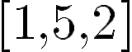
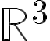
Basic Concepts of Function Analysis
In standard Linear Algebra, a vector is a list of numbers like . In Function Space, a "vector" is an entire function f(x).
Can functions compose a space? Yes. If you take two functions f(x) and g(x), you can add them (f+g)(x) or scale cf(x) them , and the result is still a function. Therefore, functions satisfy the axioms of a Vector Space.
Infinite Dimensions: A standard vector in has 3 dimensions because you only need 3 numbers to describe it. To perfectly describe a continuous function , you would need to know its value at every possible x. Since there are infinitely many points between 0 and 1, you need an "infinite list of numbers" to describe the function. Thus, these spaces (often called Hilbert Spaces) are infinite-dimensional.

Slide 7
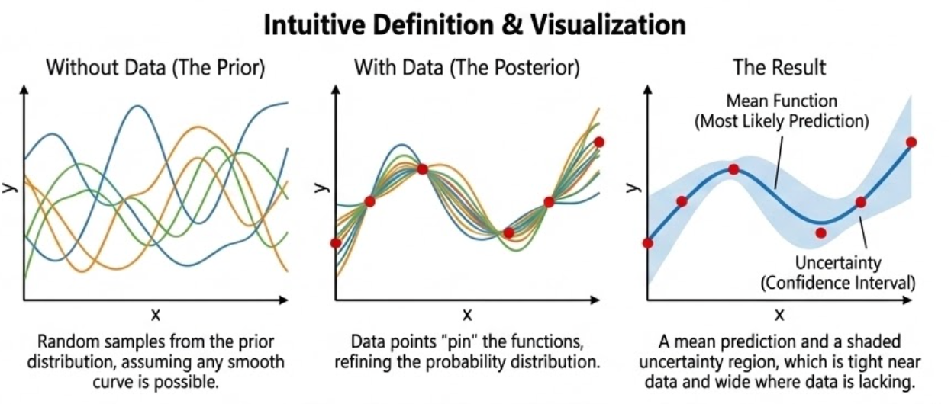
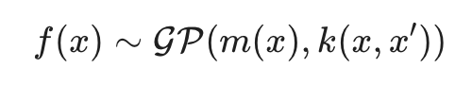
Gaussian Process
Instead of assume a specific shape of a function, a Gaussian Process assumes the function itself is a random variable defining a probability distribution over all possible functions that fit the data
Definition
m(x): Usually assumed to be zero (for simplicity) until data is observed.
k(x, x’): Kernel function that defines the similarity between two points.

Slide 8
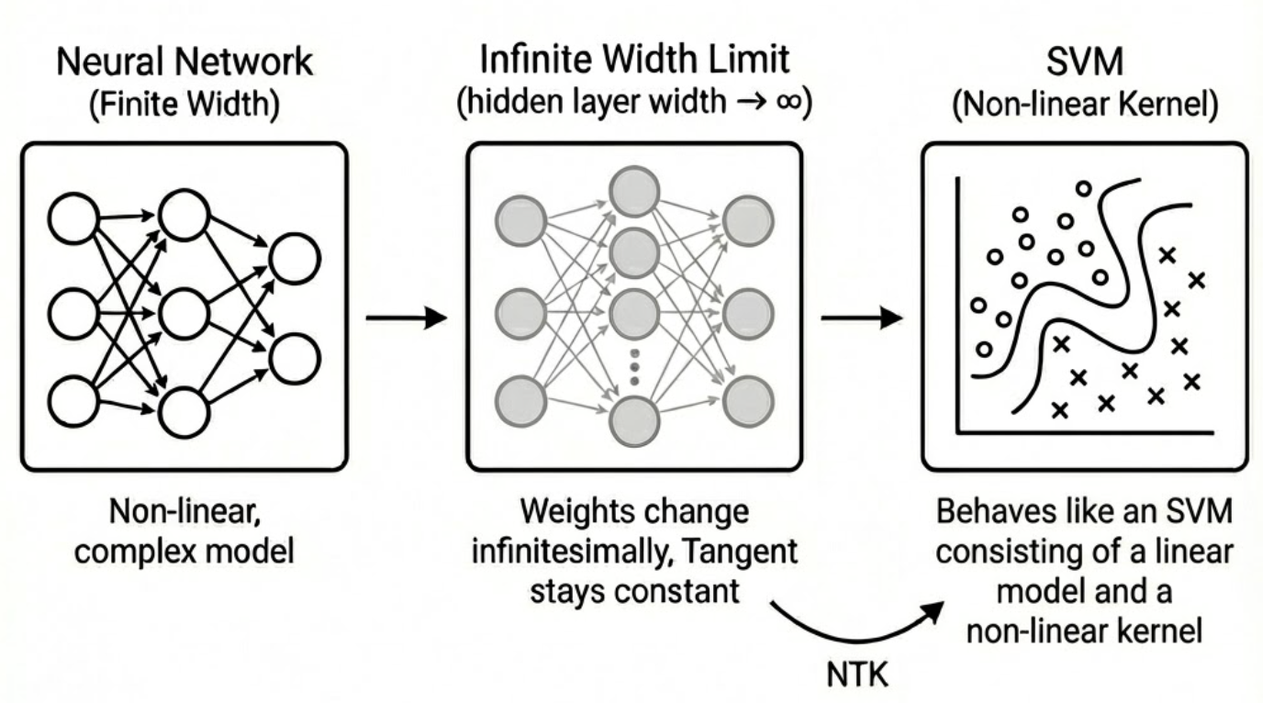
Introducing the Neural Tangent Kernel (NTK)
The Infinite Width Limit: Imagine a theoretical limit where hidden layer width → ∞. In this case, the weights change infinitely small during Gradient Descent. Because they move so little, the "tangent" (the local linear approximation of the network) stays constant.
This means a complex, non-linear neural network behaves exactly like a linear model. Specifically, it behaves like Kernel Regression. The kernel that describes this behavior is called the Neural Tangent Kernel (NTK).
When network’s width goes to infinity, the model is a Gaussian Process. The training process can be described as kernel regression with a fixed Neural Tangent Kernel.

Slide 9
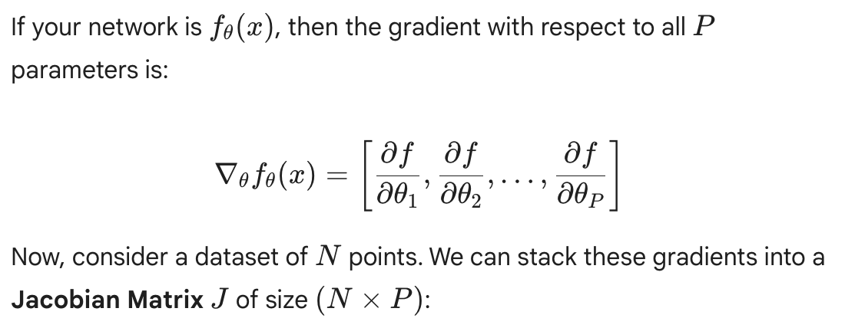
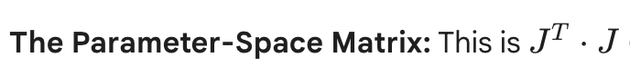
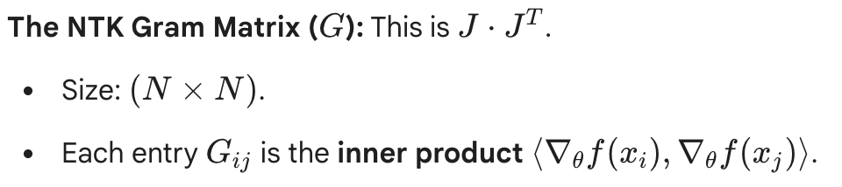
Defining the NTK: Function vs. Matrix

Slide 10
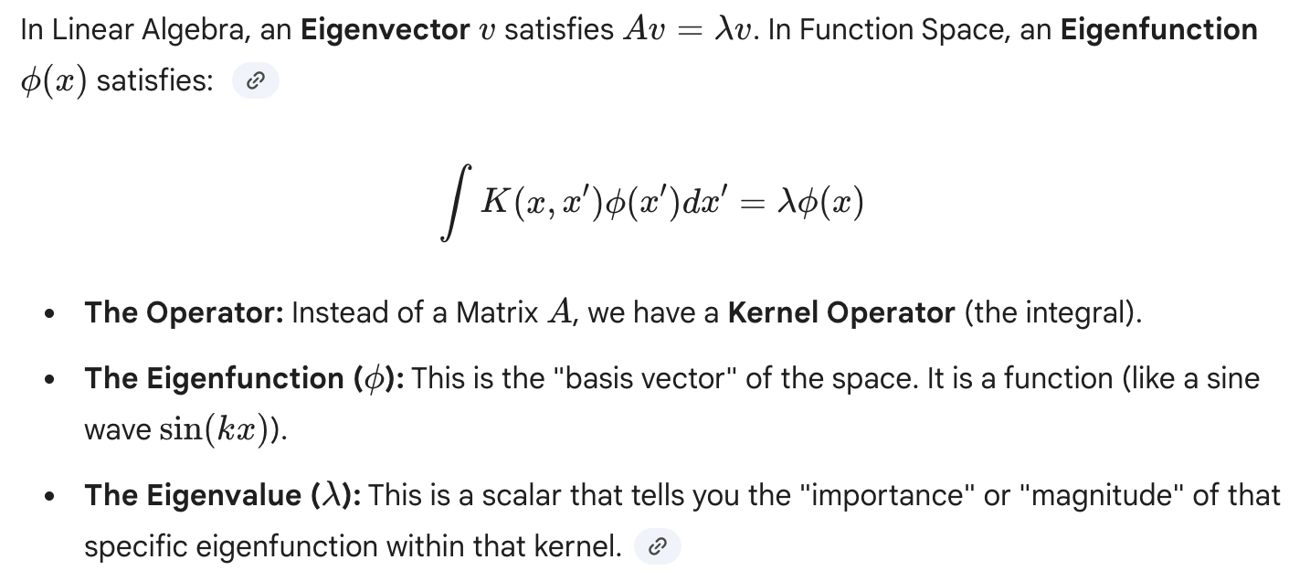
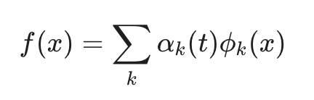
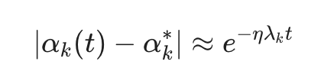
Connecting NTK and GP with Function Analysis

Slide 11
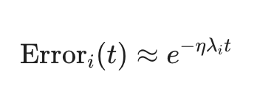
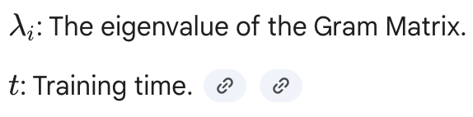
Error Reduction Rate
The "Aha!" Moment for Spectral Bias: In a neural network, the eigenfunctions with large eigenvalues are usually smooth, low-frequency waves. Because the learning speed is proportional to the eigenvalue, the loss reduction speed from these functions are exponentially faster.
Implication:
λ is like an internal learning rate that’s naturally large for low-frequency functions.
Large λ: Error decays immediately (Fast learning).
Small λ: Error stays high for a long time (Slow learning).

Slide 12
Conclusion of Part 1:
The eigendecomposition of NTK maps large eigenvalues to low-frequency eigenfunctions. Error decays as e^(-λt).

Slide 13
Part2: The Modern CNN and Nyquist-Shannon Sampling Theorem
References:
Making Convolution Networks Shift-Invariant Again https://arxiv.org/abs/1904.11486

Slide 14
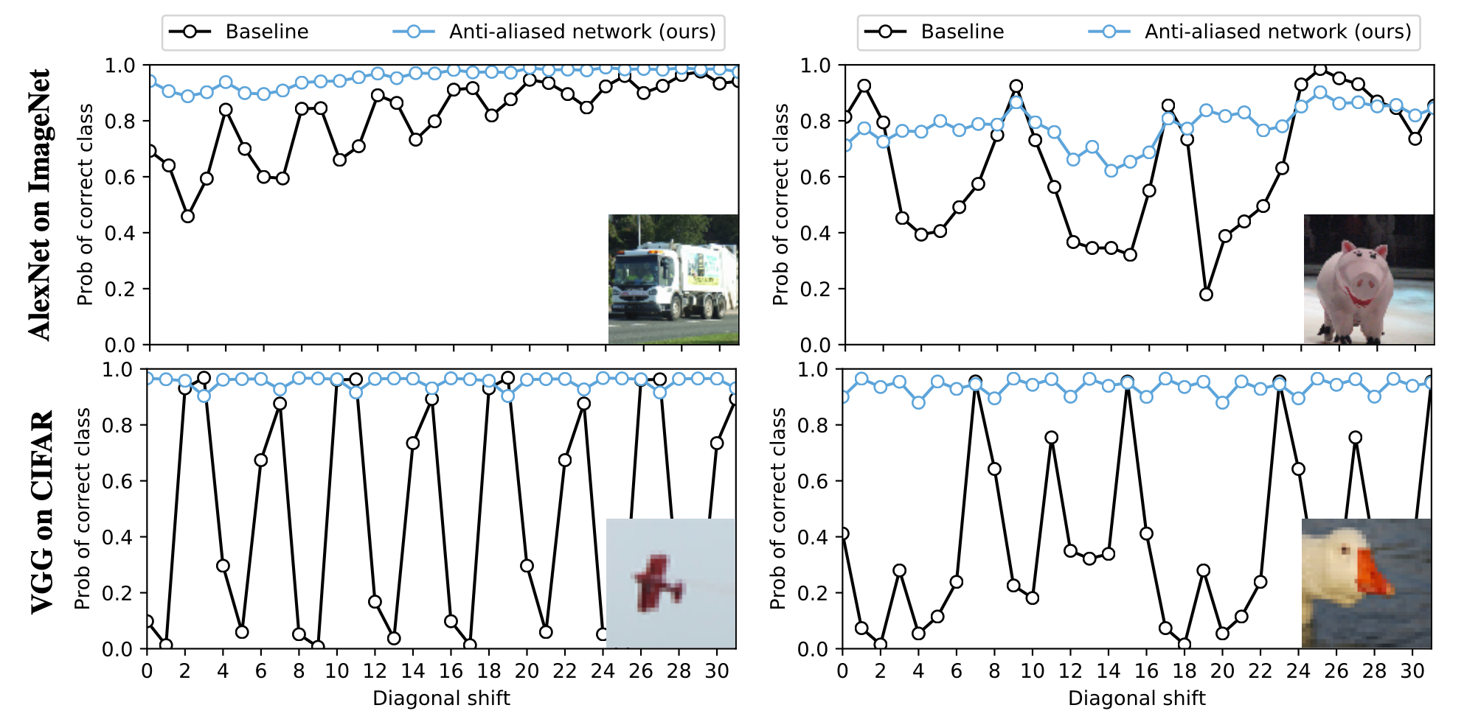
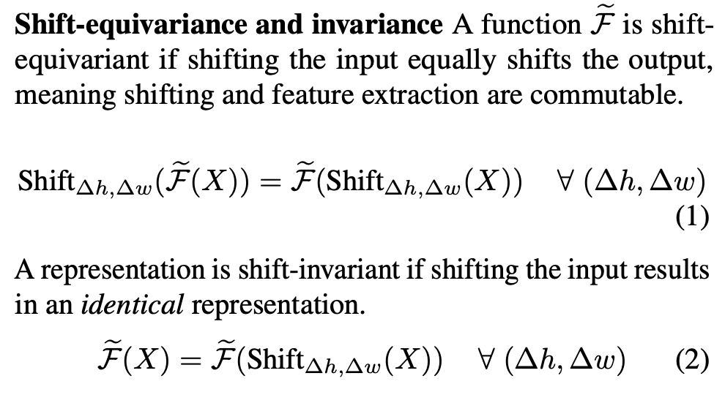
The Problem: Violating the Sampling Theorem
The Issue: Modern CNNs are not shift-invariant. A 1-pixel shift changes internal feature maps and prediction entirely.
The Cause: Downsampling violates the Nyquist-Shannon Sampling Theorem. We must sample at rate > 2x highest frequency. MaxPooling’s sampling rate does not satisfy the theorem as feature maps contain high-frequency information (textures) which MaxPooling cannot match.

Slide 15
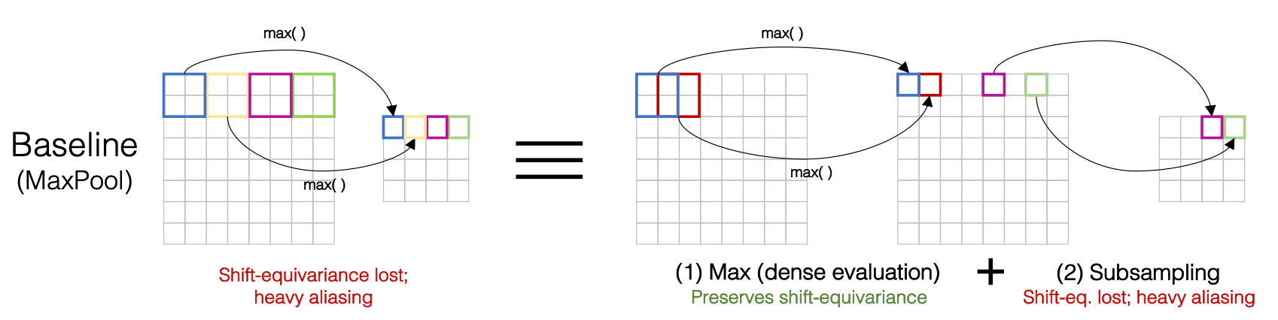
Deconstructing MaxPool
Analysis: MaxPool_S2K2 is actually two steps:
1. MaxPool_S1K2: Logically shift-equivariant.
2. Subsample_S2K2: The step where we throw away data. This is where aliasing happens.

Slide 16
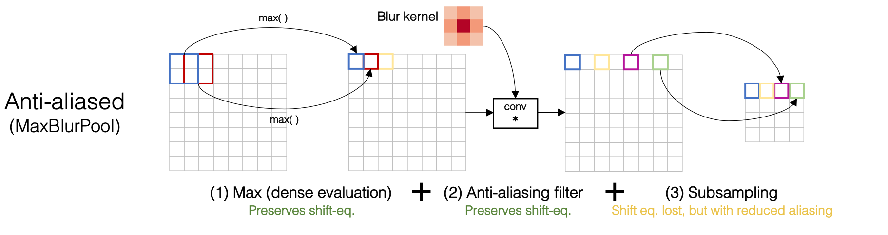
The Solution: BlurPool
Methodology: Decouple the operation.
MaxPool_S2K2 → MaxPool_S1K2 + Blur + Subsample_S2K2
Integration: Applies to ANY strided layer (Strided Conv, Avg Pool).
Kernels: Simple kernels like Triangle or Binomial-5 work best.

Slide 17
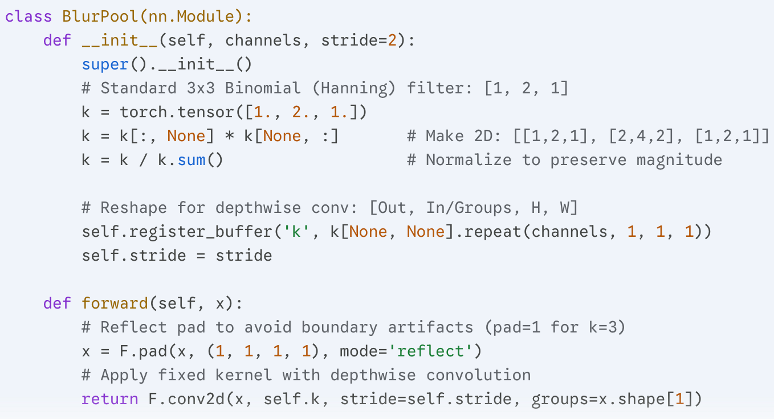
The Python Code of BlurPool

Slide 18
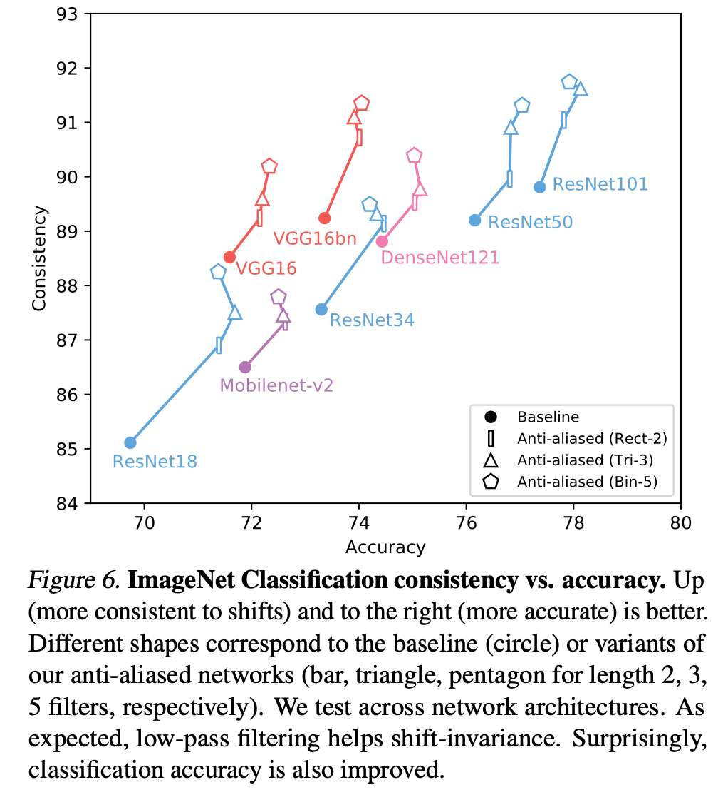
Results: Consistency & Accuracy
Consistency: Massive gain in shift-invariance (diagonal consistency).
Accuracy: Surprisingly, accuracy increases. The blur acts as regularization, removing noise.
Robustness: Better performance on ImageNet-C (corrupted data).

Slide 19
Conclusion of Part 2: Removing High Frequency Component by Blurring
Since downsampling are not shift-equivariant due to violation of the sampling theorem, we directly remove high frequency information by blurring(which removes the aliasing artifact). This gives us better performance on classification task.

Slide 20
Part3: Frequency-Aware Architecture Design
References:
Frequency Dynamic Convolution for Dense Image Prediction https://openaccess.thecvf.com/content/CVPR2025/papers/Chen_Frequency_Dynamic_Convolution_for_Dense_Image_Prediction_CVPR_2025_paper.pdf

Slide 21
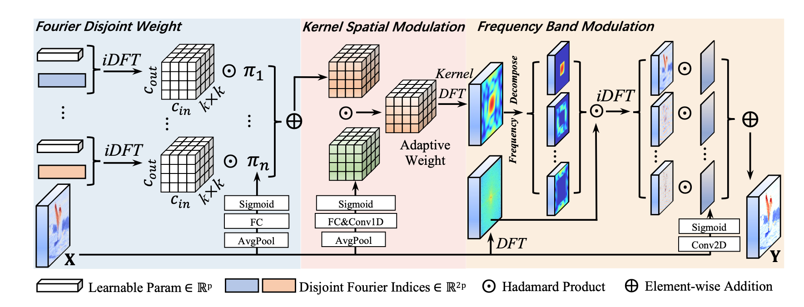
Frequency Dynamic Convolution (CVPR 2025)
Contribution: We need a convolution that handles frequencies EXPLICITLY.
The Gap: Standard Dynamic Convs (ODConv) are frequency-redundant (learn similar responses, or focusing on low frequency information).
Notes:
SPEAKER NOTE: Remember from the Spectral Bias section how we saw that NNs struggle to learn high frequencies? And in the BlurPool section, we saw how high frequencies cause aliasing? FDConv solves this by explicitly separating the kernel weights into frequency bands.

Slide 22
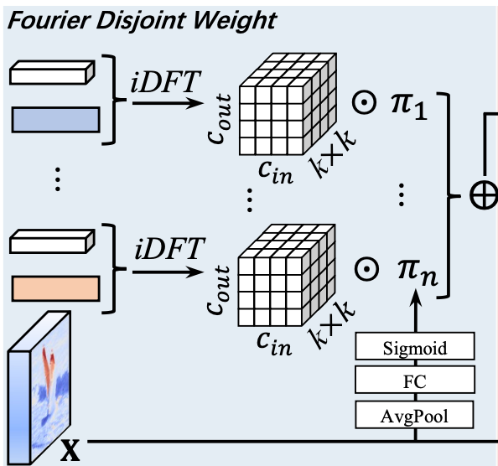
Fourier Disjoint Weight (FDW)
The Innovation: Learn spectral coefficients in the Fourier Domain instead of spatial weights.
Mechanism: Divide parameters into disjoint frequency-based groups (Low, Mid, High). This is also called ‘kernel bank’.
Process: Learn per group → Inverse DFT → Spatial Domain.
Result: Diverse kernels where some specialize in shape (low freq) and others in texture (high freq).

Slide 23
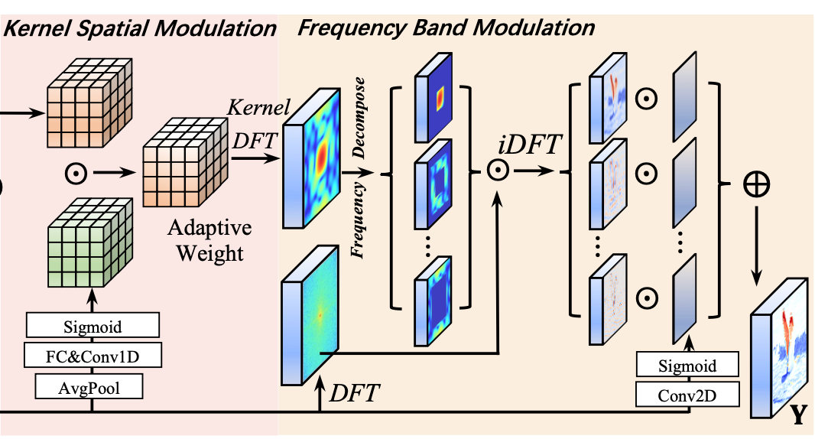
Adaptive Modulation (KSM & FBM)
Spatial Attention: Applies spatially variant modulation to specific bands.
Frequency Band Modulation (FBM): Decomposes input features into frequency bands.
Alleviating Spectral Bias: FBM allows the network to explicitly 'attend' to high-frequency bands (like object boundaries) that a standard network might ignore.

Slide 24
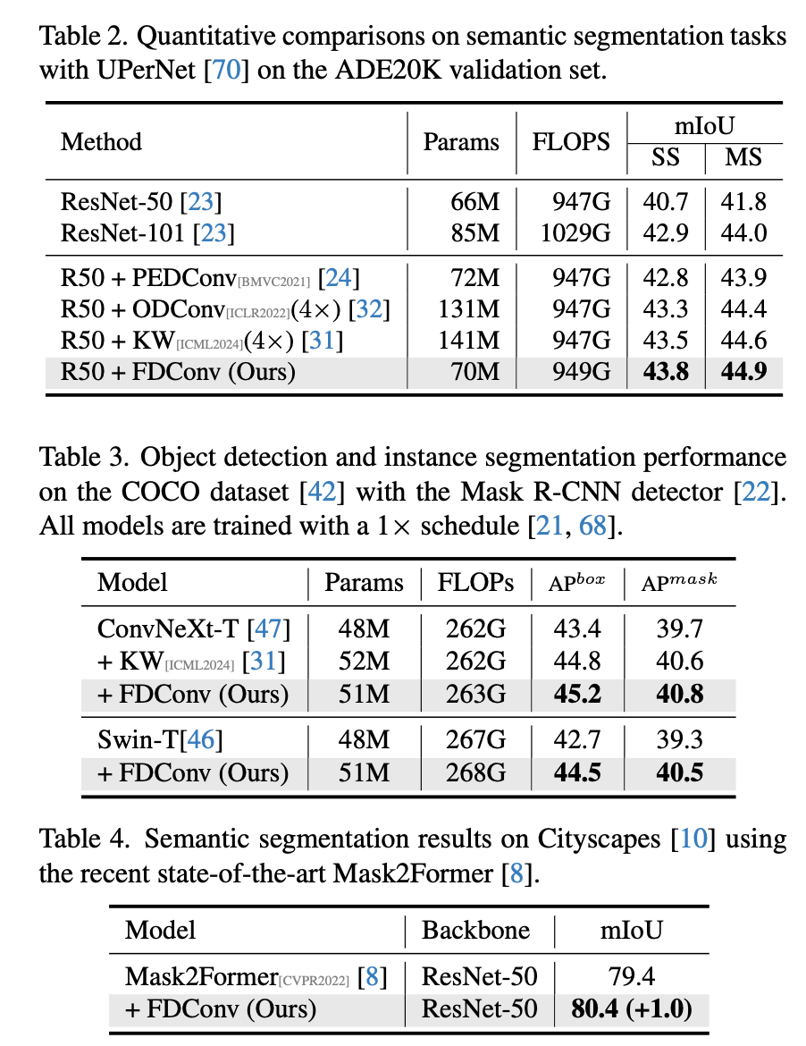
FDConv Results
Efficiency: Outperforms previous dynamic convolutions with significantly fewer parameters (+3.6M vs +90M) on semantic segmentation task.
Modulation: Network successfully modulates high frequencies specifically at object boundaries.

Slide 25
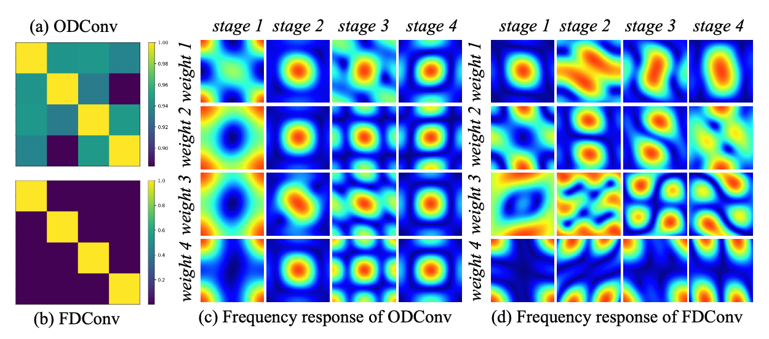
FDConv Results

Slide 26
Summary
The Spectral Bias: Neural networks are naturally biased towards low frequencies by Neural Tangent Kernel(NTK) analysis.
The Correction: Ignoring sampling theorem causes aliasing and instability; Anti-aliasing (BlurPool) fixes this.
Recent Application: We can leverage these insights to design Frequency Dynamic Convolutions (FDConv) that explicitly manage the spectrum of different frequencies.

Slide 27
Q&A

